Slide 1
CP1404 Module 8 GUI Programming with Kivy

Slide 2
Learning outcomes - you will be able to:
Use Kivy to create interactive GUI (Graphical User Interface) Python programs, including:
Creating widgets like Labels, Buttons, TextInputs…
Using BoxLayout to arrange widgets in a view
Using the Kv language to declare user interfaces
Dynamically creating widgets using Python
Programming interactions with event handlers

Slide 3
Our demos help you learn Kivy
https://github.com/CP1404/KivyDemos
Student comment: “Instead searching the internet for solutions i found it a lot easier to run programs from the kivy demos to find examples of the answers i was looking for.”

Slide 4
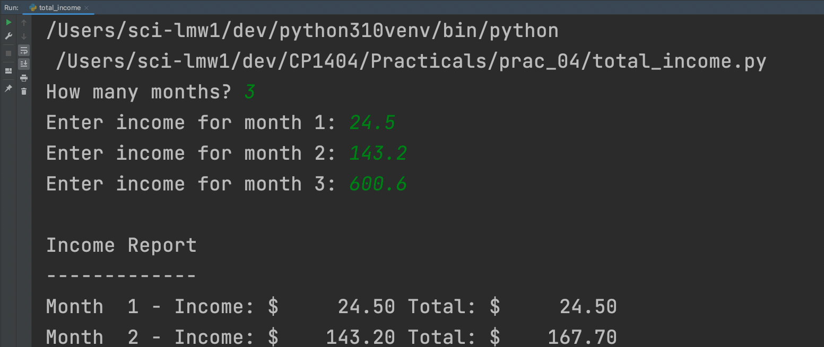
The programs we have written so far are command-line only
Information flows into a program via keyboard or file input
Information flows out of a program via the console screen, or file output
Notes:
There is another way to get input - using command-line parameters: https://docs.python.org/3.4/library/argparse.html

Slide 5
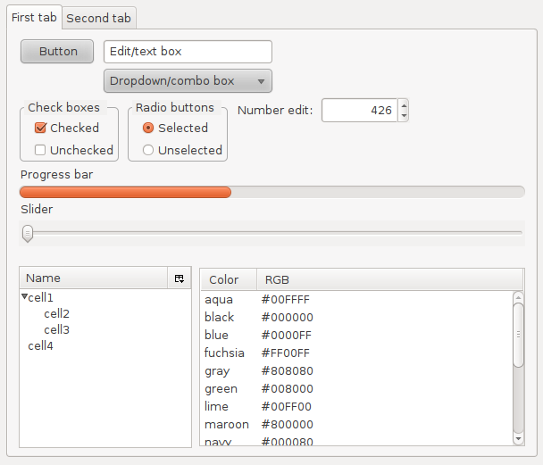
But computers support different kinds of human-computer interaction (HCI)
Modern operating systems have Graphical User Interfaces (GUIs)
The GUI allows a user to interact with a program via “widgets” - visual indicators and controls
Notes:
https://en.wikipedia.org/wiki/Widget_(GUI)
"Widgets" by MarkEchidna at the English language Wikipedia. Licensed under CC BY-SA 3.0 via Commons - https://commons.wikimedia.org/wiki/File:Widgets.png#/media/File:Widgets.png

Slide 6

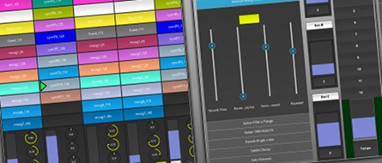
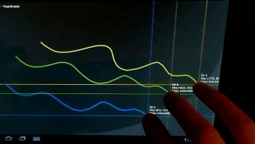
Python has several GUI frameworks available
Tkinter (built into Python)
PyQt
wxPython
…
We will learn Kivy, a popular modern GUI framework
Notes:
https://wiki.python.org/moin/GuiProgramming

Slide 7
Kivy is a GUI framework
A Kivy program consists of GUI objects, called widgets, created from Kivy classes, that can be seen on the screen
The coding process for a Kivy program is:
Import the necessary Kivy module(s)
Use Kivy classes to create widgets (objects)
Write Python code to handle interaction and program logic, including handling events
Notes:
In fact, the term “Widget” is very common: https://en.wikipedia.org/wiki/Widget_(GUI)
https://en.wikipedia.org/wiki/Widget_toolkit

Slide 8
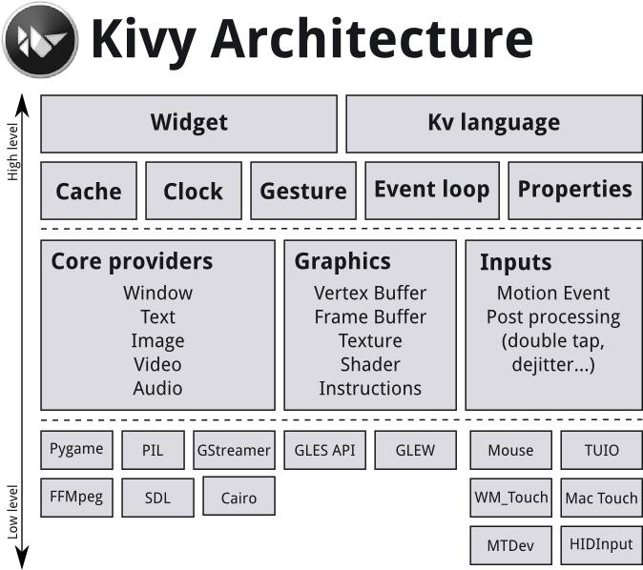
Kivy is a big GUI framework

Slide 9
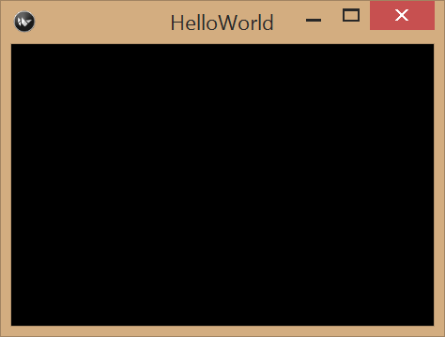
Example: “Hello World” in Kivy
from kivy.app import App
from kivy.app import Widget
class HelloWorld(App):
def build(self):
self.root = Widget()
return self.root
HelloWorld().run()

Slide 10
First, we import the needed Kivy modules
from kivy.app import App
from kivy.app import Widget
class HelloWorld(App):
def build(self):
self.root = Widget()
return self.root
HelloWorld().run()
kivy.x denotes a Python package
A package is a collection of related modules
Both App and Widget are within the app module
Notes:
https://docs.python.org/2/tutorial/modules.html#packages
Each package in Python is a directory which MUST contain a special file called __init__.py

Slide 11
Next, we define a derived App class, HelloWorld
from kivy.app import App
from kivy.app import Widget
class HelloWorld(App):
def build(self):
self.root = Widget()
return self.root
HelloWorld().run()
Our class overrides App.build() to return a Widget instance
self.root (from the App class) refers to the main widget All other widgets get added to this main root widget

Slide 12
Last, we create an instance of our App and "run" it
from kivy.app import App
from kivy.app import Widget
class HelloWorld(App):
def build(self):
self.root = Widget()
return self.root
HelloWorld().run()
We call App.run() on this (anonymous) instance
Kivy displays the root widget returned by build()
Notes:
If you don’t called run() your GUI window will not appear!

Slide 13
The bits (names)
new class is a specialised version of Kivy's App class
from kivy.app import App from kivy.app import Widget
class HelloWorld(App):
def build(self):
self.root = Widget()
return self.root
HelloWorld().run()
Class (new type)
Method (function)
reference to this instance
create new object of type HelloWorld
call method "run" of new object (Kivy defines this method)

Slide 14

Kivy is object oriented
When you create a Kivy program, you write your own new class that inherits from Kivy's App class
This means your new class "is an" App and automatically includes all of the methods and features that App has, including methods like run().
You write your own methods inside the class
self refers to the current object, so when you want to create or access a variable that your Kivy app should know about in multiple functions, use self.

Slide 15
The Kv language is how we describe the layout of widgets in a Kivy program
With Kv, we don’t actually write Python code
This is a common feature of modern GUI toolkits
The Kv language is declarative - we use it to describe what the layout is, not how it is created
What's so good about this? It supports separation of concerns
The Python code focuses on application logic and behaviour
The Kv code focuses on GUI layout
This doesn’t stop us “programmatically” defining widgets
Notes:
Other toolkits that are similar are: Android, iOS, .NET, and HTML/JS

Slide 16
“Hello Kv” - Python code for the program
from kivy.app import App
from kivy.lang import Builder
class HelloKv(App):
def build(self):
self.title = "Hello world!"
self.root = Builder.load_file('widget.kv')
return self.root
HelloKv().run()
Builder.load_file() is used to read Kv code from a Kv file and return the GUI layout declared in the Kv file

Slide 17
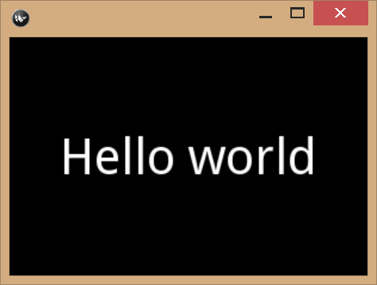
The Kv language uses similar syntactic conventions found in Python
Indentation means something is within something else
These are key-value pairs like dictionaries... that actually do get converted to dictionaries
Label:
text: "Hello"
font_size: 42
This Kv code creates a Label object with its text attribute set as "Hello" and its font size set to 42 pixels

Slide 18
The Kv language includes special layout widgets for controlling widget position
BoxLayout - widgets are positioned in a single line (horizontal or vertical)
GridLayout - widgets are positioned in a grid (rows and columns)
AnchorLayout - widgets are positioned relative to its edges (top, bottom, left, right) or its centre
… we will only focus on BoxLayout

Slide 19
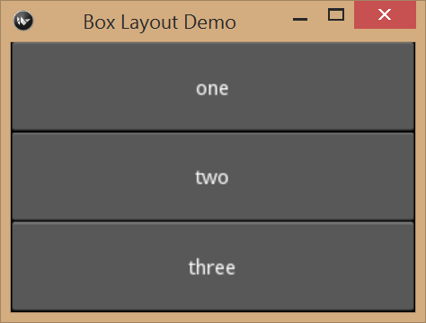
BoxLayout containing three vertical Buttons
BoxLayout:
orientation: 'vertical'
Button:
text: 'one'
Button:
text: 'two'
Button:
text: 'three'
box_layout_demo.py

Slide 20
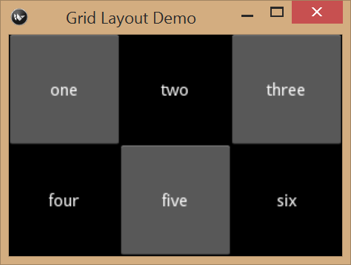
GridLayout containing Buttons and Labels
GridLayout:
rows: 2
cols: 3
Button:
text: 'one'
Label:
text: 'two'
Button:
text: 'three'
Label:
text: 'four'
Button:
text: 'five'
Label:
text: 'six'
grid_layout_demo.py
Notes:
Please note: it is enough to specify either the rows value or cols value. Although it’s better to clearly specify both!

Slide 21
Layouts can be controlled using layout hints
size_hint indicates to Kivy the sizing method for a widget
This Label is sized to fill 10% (0.1) of available vertical space and its text content is aligned horizontally to the left:
Label: text: "Kivy" size_hint_y: 0.1 halign: 'left'
Notes:
Note the meaning of the layout hints changes depending on which layout widget they are used within. For more examples, see: http://kivy.org/docs/guide/widgets.html#organize-with-layouts

Slide 22
The Kv language has three special keywords for referring to different things
self - refers to the “current” widget
app - refers to the Python App class
root - refers to the top-level widget that contains everything else
Label: text: "This is useful..." text_size: self.size halign: 'left' size_hint_y: 0.1

Slide 23
Summary of the Kv language (so far)
The root widget is first - typically it’s one of the layout widgets
BoxLayout
Indenting is how we add widgets inside other (layout) widgets
Widgets have attributes (text, font_size, …), also indented
Each widget has common attributes and specific attributes (size_hint, width, halign, ...)

Slide 24
When the user clicks on a Button widget, Kivy generates a Button event
Like all GUI toolkits, Kivy supports event-driven programming
You handle the button event by creating a callback method in your App class that Python calls when the event occurs
We associate the button with our callback by using a Button attribute, on_press (or on_release for releasing the press)
Different Kivy widgets support different kinds of events:
Mouse events, Button events, Text events, …
They are handled by using the appropriate event attribute
Notes:
https://en.wikipedia.org/wiki/Event-driven_programming
http://kivy.org/docs/guide/lang.html#event-bindings

Slide 25
Button Event Example
from kivy.app import App
from kivy.lang import Builder
class ButtonEventDemo(App):
def build(self):
self.title = "Button Event Demo"
self.root = Builder.load_file('button_event.kv')
return self.root
def press_button(self):
print("ouch!")
ButtonEventDemo().run()
BoxLayout:
Button:
text: "Press me"
on_press: app.press_button()
Notes:
Recall that app is a special keyword in Kv code for referring to the App object

Slide 26
Using Kv self allows you to send a parameter(s) to a callback
from kivy.app import App
from kivy.lang import Builder
class ButtonEventDemo(App):
def build(self):
self.title = "Button Event Demo"
self.root = Builder.load_file('button_event.kv')
return self.root
def press_button(self, button):
print('app: ' + self) # this is the app object
print(str(button) + ' says "ouch!"')
ButtonEventDemo().run()
BoxLayout:
Button:
text: "Press me"
on_press: app.press_button(self)
button_event_demo.py

Slide 27
You can set the id attribute for widgets to uniquely identify them
BoxLayout:
orientation: 'vertical'
Button:
text: "Press me"
on_press: app.handle_pressed()
Label:
id: my_label
text: "Hello world"
font_size: 42
id_demo.kv

Slide 28
This allows you to access a widget from Python using self.root.ids
from kivy.app import App
from kivy.lang import Builder
import random
class IDDemo(App):
def build(self):
self.title = "Demoing the id attribute"
self.root = Builder.load_file('id_demo.kv')
return self.root
def handle_pressed(self):
if random.randint(1, 10) <= 5:
self.root.ids.my_label.text = "ouch!!"
else:
self.root.ids.my_label.text = "stop that!!"
app = IDDemo()
app.run()
id_demo.py

Slide 29

Kivy uses the MVC design strategy Model-View-Controller
The Kv code is the view - it’s what the program looks like
The App class is the controller - it’s in charge of program behaviour
What’s the model?
Data/state of the App
Kivy Property class variables in your App class
Put model data in __init__ and view objects in build
Notes:
This is a particular type of object-oriented design: where we group related objects as “view” or “model” or “controller”. The model stores the information for the app, the controller looks after the app’s behaviour, the view presents the model’s information to the user as GUI widgets

Slide 30
Here is a StringProperty class variable for a model
from kivy.app import App
from kivy.lang import Builder
from kivy.properties import StringProperty
class MVCDemo(App):
message = StringProperty()
def build(self):
self.title = "Simple MVC Demo"
self.root = Builder.load_file('mvc.kv')
return self.root
def handle_press(self):
self.message = self.root.ids.user_input.text
MVCDemo().run()
mvc_demo.py

Slide 31
Here is how we access the model from the view
BoxLayout:
Label:
text: app.message
font_size: 42
TextInput:
id: user_input
multiline: False
on_text_validate: app.handle_press()
on_text_validate is an event that occurs when Enter is pressed in a TextInput field

Slide 32
When self.message changes (model), the Label text (view) is automatically updated
BoxLayout:
Label:
text: app.message
font_size: 42
TextInput:
id: user_input
multiline: False
on_text_validate: app.handle_press()
This is called the “observer pattern”
The Label is observing changes to app’s message

Slide 33
Kivy has a variety of property types
StringProperty - an observed string
NumericProperty - an observed number
ObjectProperty - an arbitrary observed object
ListProperty - an observed list of items
…
A default value can be provided when creating the property

Slide 34
Different GUI/Console targets helps us with SRP
Single Responsibility Principle – functions should "do one thing"
Should your function print, or get input? Maybe…
What if we were using them for a console program AND a GUI one?
Functions should do all of their job and no more.
Notes:
load without print vs. with print

Slide 35
You can create widgets dynamically with Python
If your GUI is static, create your widgets in Kv code in a .kv file
If your GUI is dynamic, create widgets programmatically in Python
Here, we:
create one Button per item in a list (items)
bind a click handler function (press_item)
add this Button to an existing layout widget (with some_id).
for item in self.items: temp_button = Button(text=item) temp_button.bind(on_release=self.press_item) self.root.ids.some_id.add_widget(temp_button)
dynamic_widgets.py

Slide 36
You can run code at the start/end of a program
Kivy has event functions for when your program starts and stops
You don’t call these, Kivy does. You define them if you want custom behaviour (like saving state to a file when the user quits)
def on_start(self): """Run when the app starts...""" ... def on_stop(self): """Run when the app exits...""" ...

Slide 37
More Kivy!

Slide 38
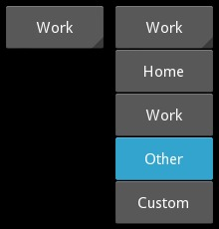
Spinner is a drop-down list widget
Provides a quick way to select one value from a list
Spinner has a values property, which is a list
Use on_text for when the text changes, which is when the user changes the selection
Spinner: text: app.current_value values: app.values on_text: app.change_value(self.text)
spinner_demo.py

Slide 39
Popup is a kind of popup "window"
These are not like separate floating windows, but appear on top
You create the popup, then hide it and open() or dismiss() it when you want
Popup: id: popup title: "Add Item" BoxLayout: …
popup_demo.py

Slide 40
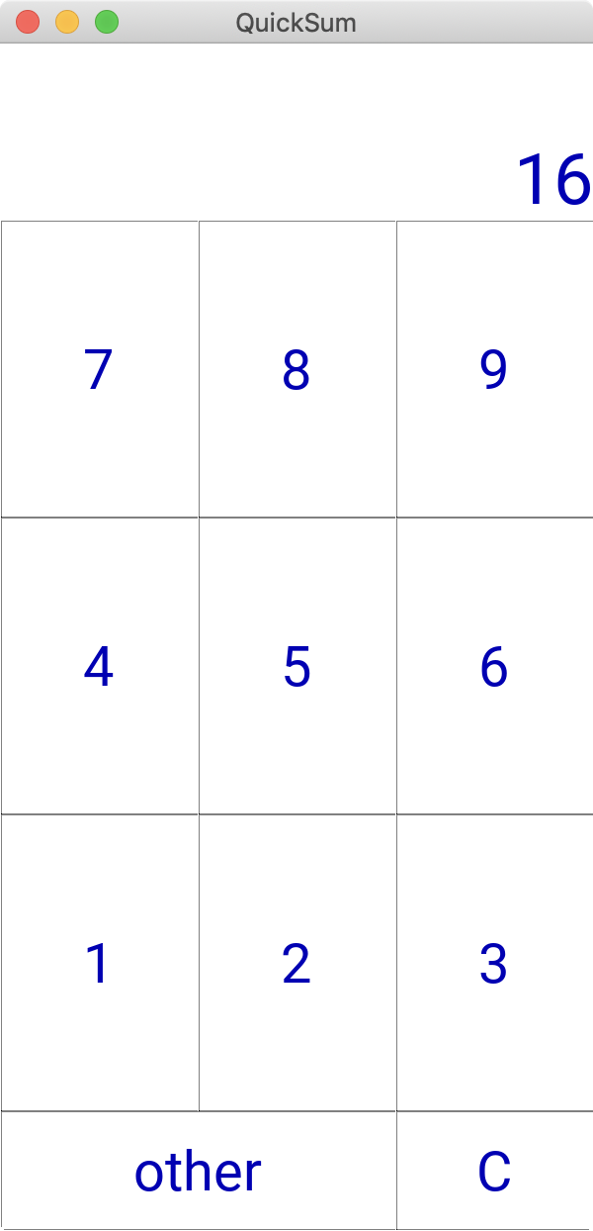
See our QuickSum example for custom styling
Jason uses this to quickly and accurately add up marks for various things (exams, assignments, etc.)
quick_sum_app.py

Slide 41
QuickSum - things to note:
The use of class rules in the Kv file
e.g. <Button>: applies to all Buttons
The use of canvas.before and canvas.after to change the background colour or other aspects of a widget
The use of alternative fonts and button images
Using the children property of a widget allows you to access the widgets added inside
The use of Window.size to control the window size

Slide 42
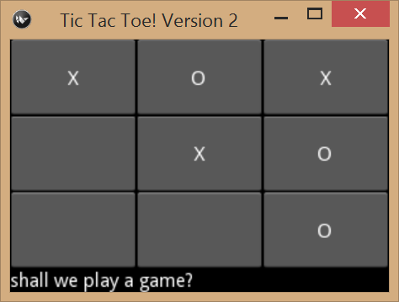
How are things actually drawn on the screen?
Every Kivy widget object has a canvas attribute
The canvas attribute is a Canvas object
Canvas supports various drawing functionality
Each Button, Label, etc. all have their own canvas attribute that makes them look the way they do...
Notes:
Other GUI toolkits are similar to Kivy… many have a “canvas” that you draw shapes on to...

Slide 43
You make custom 2D drawings using the canvas attribute of a widget
Kivy offers a collection of graphics objects
Rectangle, Ellipse, Line, Color, etc...
You add these objects to a canvas to draw what you want
Kivy, its providers, and the OS all work together to draw the canvas content on the screen

Slide 44
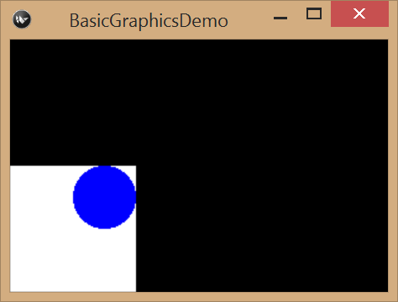
Example - 2D drawing
class BasicGraphicsDemo(App): def build(self): self.root = Widget() # white rectangle 100x100 self.root.canvas.add(Color(1, 1, 1, 1)) self.root.canvas.add(Rectangle(size=(100, 100))) # blue circle 50x50 self.root.canvas.add(Color(0, 0, 1, 1)) self.root.canvas.add(Ellipse(size=(50, 50), pos=(50, 50))) return self.root
basic_graphics_demo.py
Notes:
In the Kivy examples online, you will see the use of the with statement - this is syntactic sugar that simplifies adding graphics objects to a widget canvas: http://kivy.org/docs/api-kivy.graphics.html

Slide 45
More from the KivyDemos repo
clock_demo
A Clock object and its schedule_interval() method, which allows a callback function to execute on a regular basis
clock_demo2
A GUI with two Buttons and a Label
The Label is updated by scheduled callback function
The Buttons are used to start/stop the regular updates
simple_animation_demo
A callback function is used to move 2D objects on the canvas for a widget - thus giving the illusion of motion

Slide 46
Things to note...
Clock.schedule_interval() has two parameters
The first is the callback function
The second is the interval (in seconds)
The smallest interval possible is determined by the speed of the system
The size and position of 2D objects drawn on any canvas don’t respect the layout of its widget
Use the root widget’s canvas when custom drawing in Kivy for simplicity
Notes:
It is possible to use any widget’s canvas… but you have to do work to make the 2D objects display relative to the size and position of the widget, see: http://kivy.org/docs/guide/widgets.html#adding-a-background-to-a-layout
Technically, the Clock.schedule_interval() method returns a ClockEvent object...

Slide 47
Summary
Kivy is a powerful GUI framework that allows you to create interactive GUI programs
It offers the use of the observer pattern for easily accessing and changing the GUI element states from Python code
Use the Kivy Demos provided as starting points and examples for your programs

